Slide 1
DF-GAN: A simple and effective baseline for Text-to-Image Synthesis
Phạm Bùi Nhật Huy
Nguyễn Thị Như Vân
20521410
20520855
Notes:
Được công bố tại CVPR 2022

Slide 2
01
Introduction

Slide 3
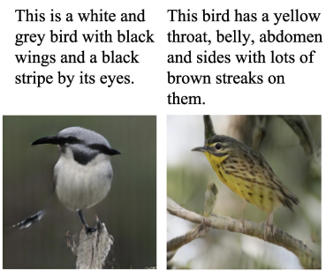
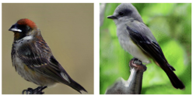
Introduction
The last few years have witnessed the great success of
Generative Adversarial Networks (GANs) for a variety of applications.
Among them, text-to-image synthesis is one of the most important applications of GANs.

Slide 4

Introduction
Two major challenges for text-to-image synthesis are:
Authenticity of the generated image
The semantic consistency between the given text and the generated image

Slide 5
Introduction
Due to the instability of the GAN model, most recent models adopt the stacked architecture as the backbone to generate high-resolution images.
Han Zhang, Tao Xu, Hongsheng Li, Shaoting Zhang, Xiaogang Wang, Xiaolei Huang, and Dimitris N Metaxas. Stackgan: Text to photo-realistic image synthesis with stacked generative adversarial networks. In Proceedings of the IEEE international conference on computer vision, pages 5907–5915, 2017
Han Zhang, Tao Xu, Hongsheng Li, Shaoting Zhang, Xiaogang Wang, Xiaolei Huang, and Dimitris N Metaxas. Stackgan++: Realistic image synthesis with stacked generative adversarial networks. IEEE TPAMI, 41(8):1947–1962, 2018.

Slide 6
Introduction
They employ cross-modal attention to fuse text and image features and then introduce DAMSM network, cycle consistency, or Siamese network to ensure the textimage semantic consistency by extra networks.
DAMSM: Tao Xu, Pengchuan Zhang, Qiuyuan Huang, Han Zhang, Zhe Gan, Xiaolei Huang, and Xiaodong He. Attngan: Finegrained text to image generation with attentional generative adversarial networks. In Proceedings of the IEEE conference on computer vision and pattern recognition, pages 1316–1324, 2018
Cycle consistency: Tingting Qiao, Jing Zhang, Duanqing Xu, and Dacheng Tao. Mirrorgan: Learning text-to-image generation by redescription. In Proceedings of the IEEE Conference on Computer Vision and Pattern Recognition, pages 1505–1514, 2019.
Siamese network: Guojun Yin, Bin Liu, Lu Sheng, Nenghai Yu, Xiaogang Wang, and Jing Shao. Semantics disentangling for text-to-image generation. In Proceedings of the IEEE Conference on Computer Vision and Pattern Recognition, pages 2327–2336, 2019.
Notes:
Người ta nghiên cứu và sử dụng cross-modal attention để kết hợp các đặc trưng văn bản và hình ảnh sau đó đưa vào mạng DAMSM, hoặc cycle consistency, hoặc Siamese networks để đảm bảo tính nhất quán về ý nghĩa giữa văn bản và hình ảnh.
DAMSM: Deep Attentional Multimodal Similarity Model - With an attention mechanism, the DAMSM is able to compute the similarity between the generated image and the sentence using both the global sentence level information and the fine-grained word level information. Thus, the DAMSM provides an additional fine-grained image-text matching loss for training the generator.

Slide 7
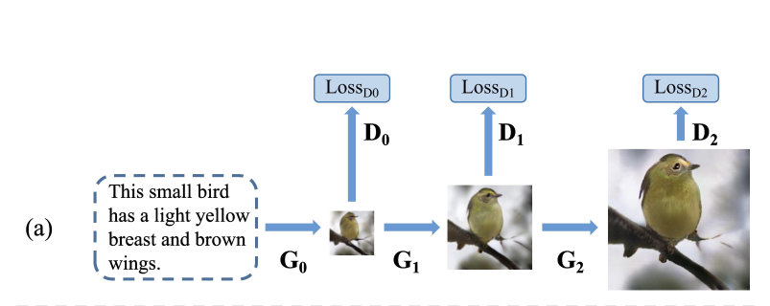
Introduction
Although impressive results have been presented by previous works there still remain three problems.

Slide 8
Introduction
For the first issue, replace the stacked backbone with a one-stage backbone. It is composed of hinge loss and residual networks which stabilizes the GAN training process to synthesize high-resolution images directly.
For the second issue, we design a Target-Aware Discriminator composed of Matching-Aware Gradient Penalty (MA-GP) and One-Way Output to enhance the text-image semantic consistency.
For the third issue, we propose a Deep text-image Fusion Block (DFBlock) to fuse the text information into image features more effectively

Slide 9
02
Related works

Slide 10
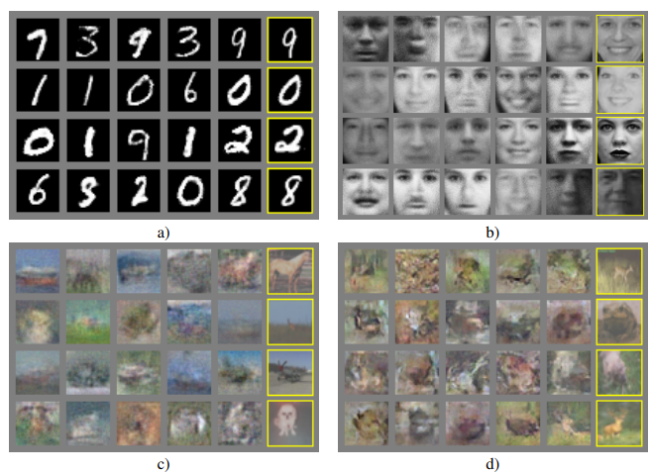
Related works
GANs: Ian Goodfellow, Jean Pouget-Abadie, Mehdi Mirza, Bing Xu, David Warde-Farley, Sherjil Ozair, Aaron Courville, and Yoshua Bengio. Generative adversarial nets. In Advances in Neural Information Processing Systems, pages 2672–2680, 2014
Notes:
Mô hình GAN được giới thiệu bởi Ian J. Goodfellow vào năm 2014 và đã đạt được rất nhiều thành công lớn trong Deep Learning nói riêng và AI nói chung.
GAN cấu tạo gồm 2 mạng là Generator và Discriminator. Trong khi Generator sinh ra các dữ liệu giống như thật thì Discriminator cố gắng phân biệt đâu là dữ liệu được sinh ra từ Generator và đâu là dữ liệu thật có.

Slide 11
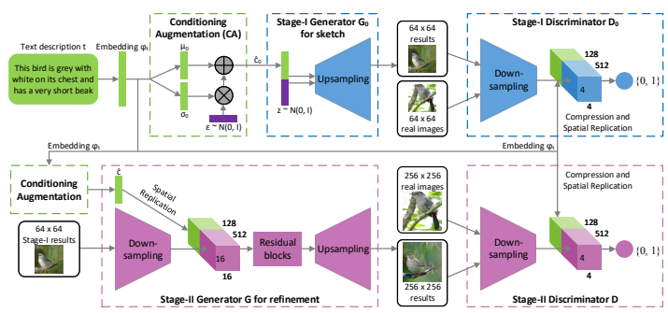
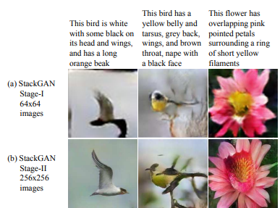
Related works
Stackgan: Text to photo-realistic image synthesis with stacked generative adversarial networks. In Proceedings of the IEEE international conference on computer vision, pages 5907–5915, 2017
Notes:
StackGAN: sinh ra ảnh chất lượng cao bằng cách xếp chồng nhiều generators và discriminators (kiến trúc xếp tầng), bổ sung text information cho generator bằng cách nối các vector văn bản cùng với các input noises.

Slide 12
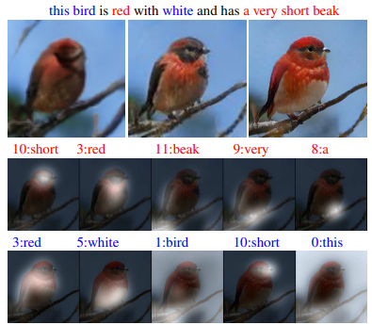
Related works
Attngan: Finegrained text to image generation with attentional generative adversarial networks. In Proceedings of the IEEE conference on computer vision and pattern recognition, pages 1316–1324, 2018
Notes:
cross-modal attention mechanism → giúp bộ generator xây dựng/tổng hợp ảnh với nhiều chi tiết hơn.

Slide 13
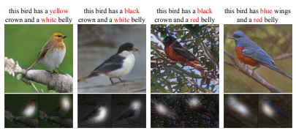
Related works
Mirrorgan: Learning text-to-image generation by redescription. In Proceedings of the IEEE Conference on Computer Vision and Pattern Recognition, pages 1505–1514, 2019.
Notes:
MirrorGAN: tái tạo (regenerate) text description từ ảnh được generated để đảm bảo tính nhất quán về mặt ý nghĩa giữa văn bản và hình ảnh

Slide 14
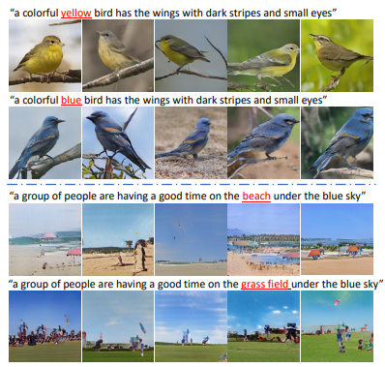
Related works
SD-GAN: Semantics disentangling for text-to-image generation. In Proceedings of the IEEE Conference on Computer Vision and Pattern Recognition, pages 2327–2336, 2019.

Slide 15
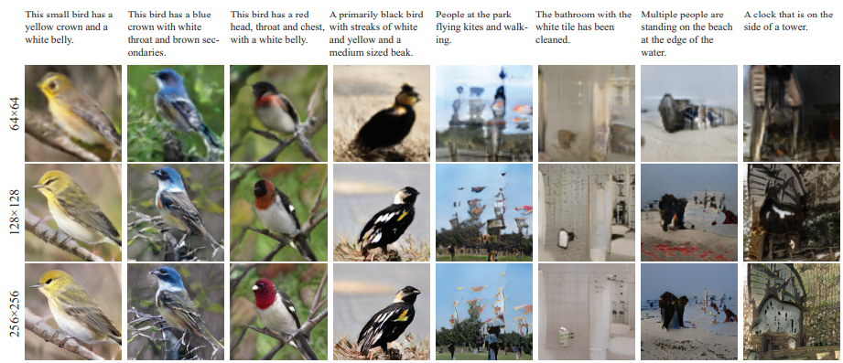
Related works
DM-GAN: Dynamic memory generative adversarial networks for text-to-image synthesis. In Proceedings of the IEEE Conferenceon Computer Vision and Pattern Recognition, pages 5802–5810, 2019

Slide 16
03
The proposed DF-GAN

Slide 17
The proposed DF-GAN
3.1
3.2
Model overview
One-Stage Text-to-Image backbone
3.3
3.4
Target-Aware Discriminator (Matching-Aware Gradient-Penalty, One-Way Output)
Efficient text-image fusion

Slide 18
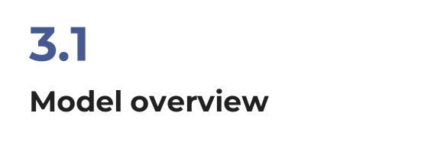

Please keep this slide for attribution

Slide 19
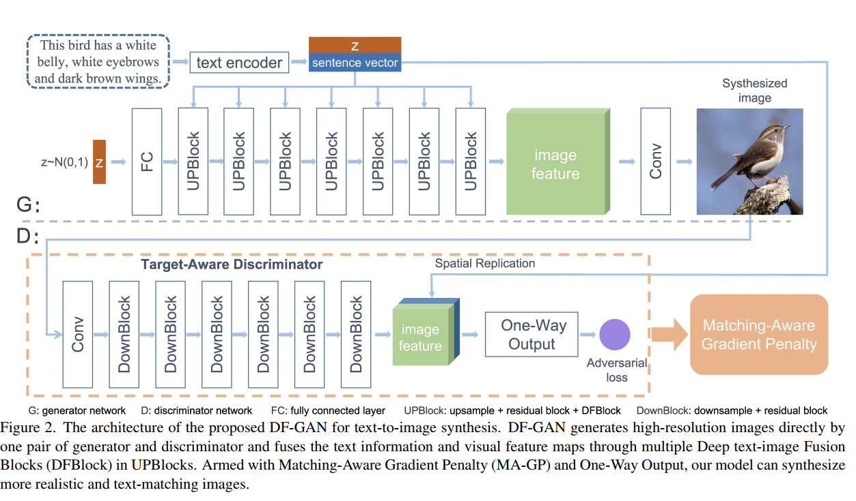

Model overview
The proposed DF-GAN is composed of a generator, a discriminator, and a pre-trained text encoder

Slide 20
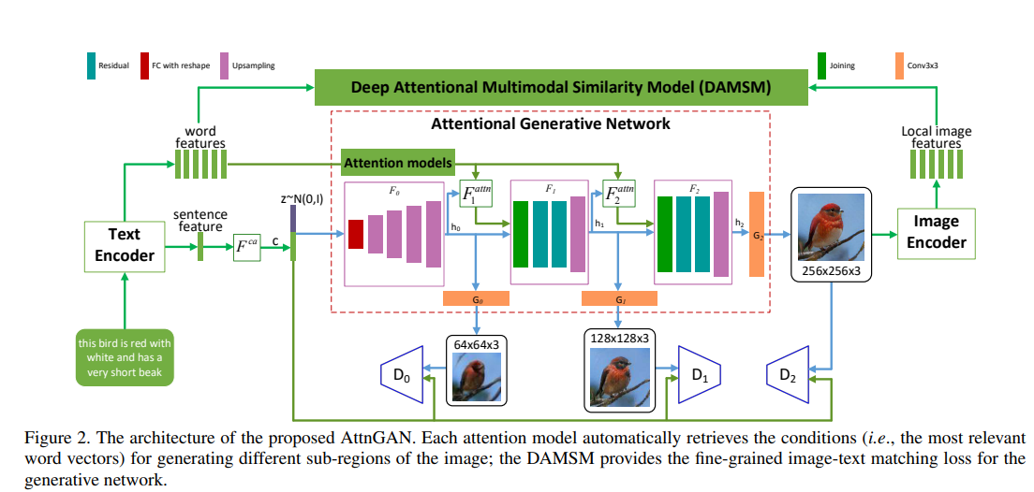
Model overview
The text encoder is a bi-directional Long Short-Term Memory (LSTM) that extracts semantic vectors from the text description. We directly use the pre-trained model provided by AttnGAN.
Notes:
Text encoder là một bi-directional LSTM, trích xuất các semantic vectors (các vector ngữ nghĩa) từ text description. Nhóm nghiên cứu sử dụng sẵn pre-trained model từ AttnGAN.

Slide 21
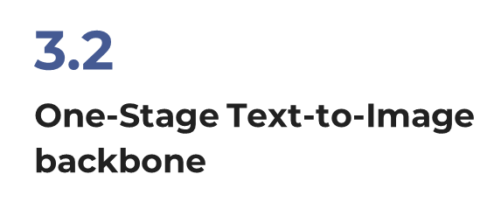
Please keep this slide for attribution

Slide 22
One-Stage Text-to-Image backbone
Propose a one-stage text-to-image backbone that can synthesize high-resolution images directly by a single pair of generator and discriminator.
Employ the hinge loss to stabilize the adversarial training process.
As the single generator in our one-stage framework needs to synthesize high-resolution images from noise vectors directly, it must contain more layers than previous generators in stacked architecture.
To train these layers effectively, we introduce residual networks to stabilize the training of deeper networks.

Slide 23
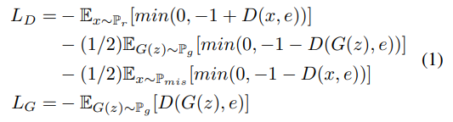
One-Stage Text-to-Image backbone
The formulation of our one-stage method with hinge loss is as follows:

Slide 24
3.3
Target-Aware Discriminator (Matching-Aware Gradient-Penalty, One-Way Output)
Please keep this slide for attribution

Slide 25

Target-Aware Discriminator
In this section, we detailed the proposed Target-Aware Discriminator, which is composed of Matching-Aware Gradient Penalty (MA-GP) and One-Way Output.
The Target-Aware Discriminator promotes the generator to synthesize
more realistic and text-image semantic-consistent images

Slide 26
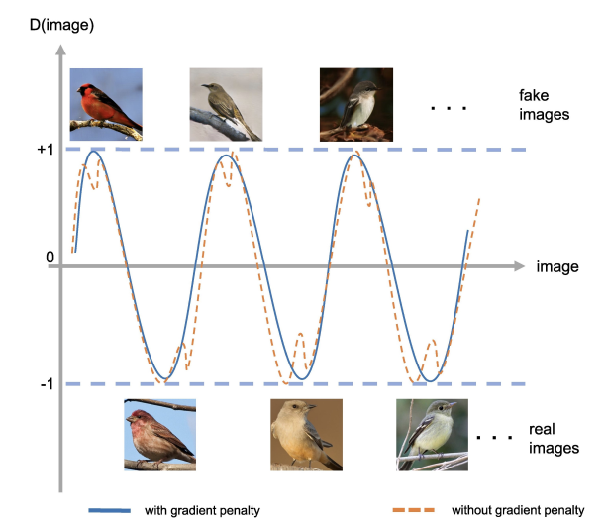
Matching-Aware Gradient Penalty
The Matching-Aware zero-centered Gradient Penalty (MA-GP) is newly designed strategy to enhance text-image semantic consistency.
Target data → low discriminator loss
Synthesis images → high discriminator loss
Hinge loss limits the discriminator loss between -1 and 1
The GP on real data will reduce the gradient of the real data point and its vicinity
The surface of the loss function around the real data point is then smoothed which is helpful for the synthetic data point to converge to the real data point

Slide 27
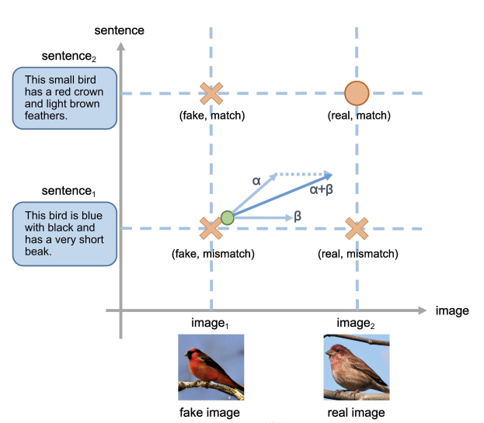
Matching-Aware Gradient Penalty
In text-to-image generation, the discriminator observes 4 kinds of inputs:
synthetics images with matching text (fake, match)
synthetics images with mismatching text (fake, mismatch)
real images with matching text (real, match)
real images with mismatch text (real, mismatch)
Notes:
Có thể thấy, từ figure phía trên, trong bài toán text-to-image generation, discriminator observer 4 loại inputs:
synthetics images with matching text (fake, match)
synthetics images with mismatching text (fake, mismatch)
real images with matching text (real, match)
real images with mismatch text (real, mismatch)

Slide 28
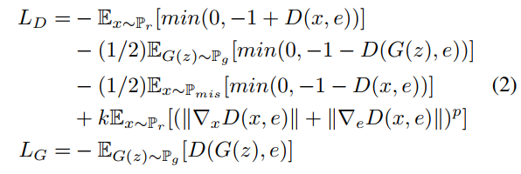
Matching-Aware Gradient Penalty
For text-visual semantic consistency, we tend to apply gradient penalty on the text-matching real data, the target of text-to-image synthesis.
Therefore, in MA-GP, the gradient penalty should be applied on real images with matching text.
The whole formulation of our model with MA-GP is as follows:
Notes:
p = 6 k = 2.0

Slide 29
Matching-Aware Gradient Penalty
By using the MA-GP loss as a regularization on the discriminator
→ our model can better converge to the text-matching real data
synthesizing more text-matching images.
The discriminator is jointly trained in our network → prevents the generator from synthesizing adversarial features of the fixed extra network.
MA-GP does not incorporate any extra networks for text-image consistency and the gradients are already computed by back propagation process
→ the only computation introduced by our proposed MA-GP is the gradient summation, which is more computational friendly than extra networks.

Slide 30
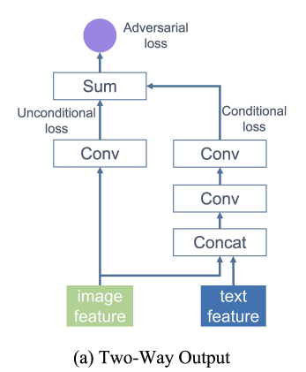
One-Way Output
One determines whether the image is real or fake
The other concatenates the image feature and sentence vector to evaluate text-image semantic consistency
→ The unconditional loss and conditional loss are computed

Slide 31
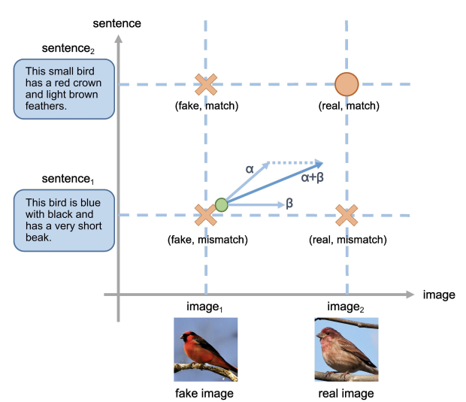
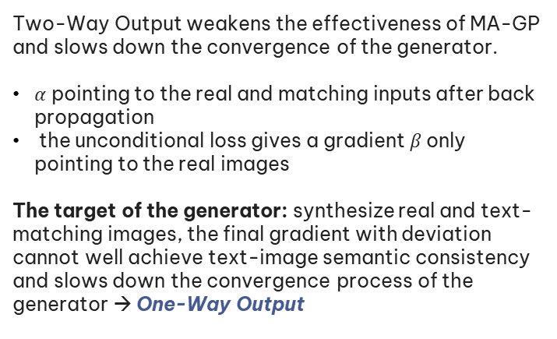
One-Way Output
Two-Way Output weakens the effectiveness of MA-GP and slows down the convergence of the generator.
$α$ pointing to the real and matching inputs after back propagation
the unconditional loss gives a gradient $β$ only pointing to the real images
The target of the generator: synthesize real and text-matching images, the final gradient with deviation cannot well achieve text-image semantic consistency and slows down the convergence process of the generator → One-Way Output

Slide 32
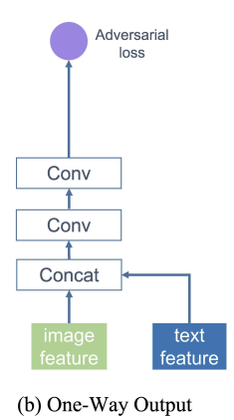
One-Way Output
The discriminator concatenates the image feature and sentence vector, then outputs only one adversarial loss through two convolution layers.
Through the One-Way Output, we are able to
make the single gradient γ pointed to the target data points (real and match) directly, which optimize and accelerate the convergence of the generator.

Slide 33
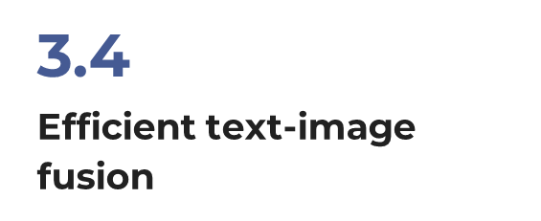
Please keep this slide for attribution

Slide 34
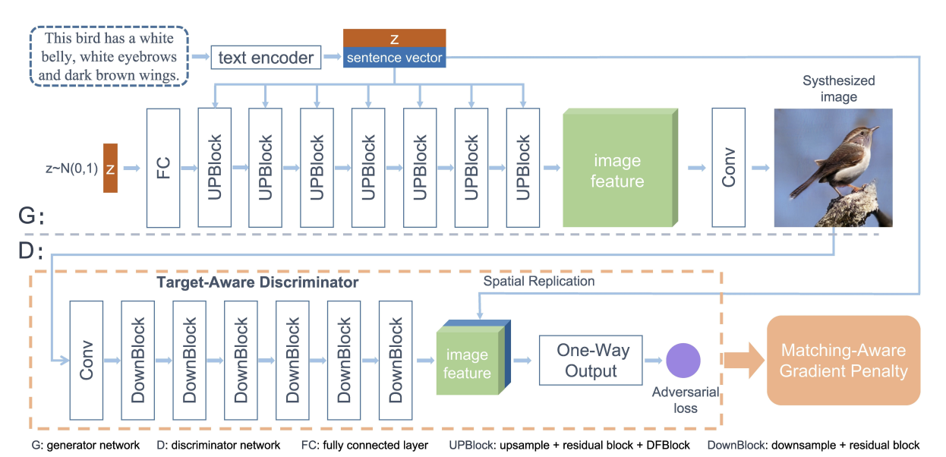
Efficient Text-Image Fusion
The generator of our DF-GAN consists of 7 UPBlocks.

Slide 35
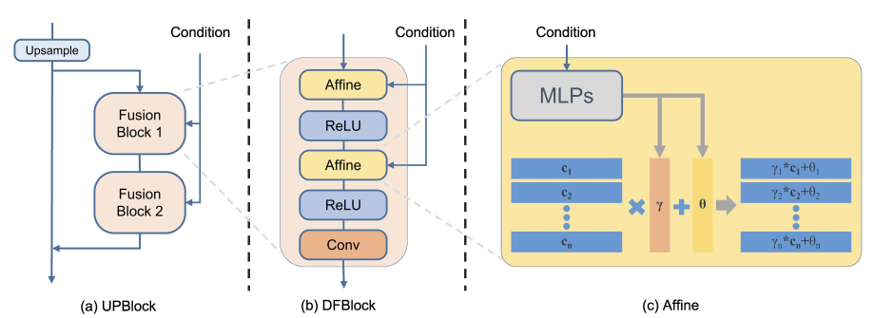
Efficient Text-Image Fusion

Slide 36
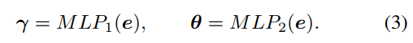
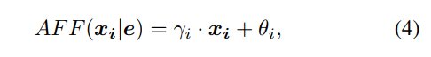
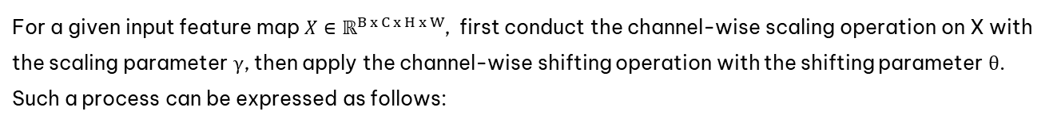
Efficient Text-Image Fusion
For Affine transformation, adopt two MLPs (Multilayer Perceptron) to predict the language-conditioned channel-wise scaling parameters γ and shifting parameters θ from sentence vector e, respectively:
For a given input feature map $X∈ℝ^{B x C x H x W}$, first conduct the channel-wise scaling operation on X with the scaling parameter γ, then apply the channel-wise shifting operation with the shifting parameter θ. Such a process can be expressed as follows:

Slide 37
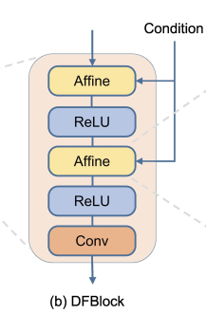
Efficient Text-Image Fusion
The Affine layer expands the conditional representation space of the generator. However, the Affine Transformation is a linear transformation for each channel.
Limit the effectiveness of text-image fusion process.
Solution: add a ReLU layer between 2 Affine layer
-> Brings the nonlinearity into the fusion process

Slide 38
Efficient Text-Image Fusion
DFBlock is partly inspired by Conditional Batch Normalization (CBN) and Adaptive Instance Normalization (AdaIN) which contain the Affine transformation.
Harm De Vries, Florian Strub, Jer´ emie Mary, Hugo Larochelle, Olivier Pietquin, and Aaron C Courville. Modulating early visual processing by language. In Advances in Neural Information Processing Systems, pages 6594–6604, 2017
Xun Huang and Serge Belongie. Arbitrary style transfer in real-time with adaptive instance normalization. In Proceedings of the IEEE International Conference on Computer Vision, pages 1501–1510, 2017
Sergey Ioffe and Christian Szegedy. Batch normalization: Accelerating deep network training by reducing internal covariate shift. In International Conference on Machine Learning, 2015.
Notes:
DFBlock một phần được lấy cảm hứng từ Conditional Batch Normalization (CBN) và Adaptive Instance Normalization (AdaIN), cả 2 phương pháp này đều có sử dụng Affine transformation.

Slide 39

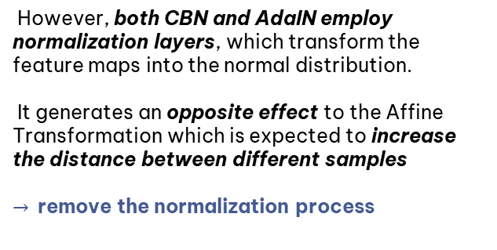
Efficient Text-Image Fusion
However, both CBN and AdaIN employ normalization layers, which transform the feature maps into the normal distribution.
It generates an opposite effect to the Affine Transformation which is expected to increase the distance between different samples
$→$ remove the normalization process

Slide 40
Efficient Text-Image Fusion
With the deepening of the fusion process, the DFBlock brings two main benefits for text-to-image generation:
It makes the generator more fully exploit the text information when fusing text and image features
Deepening the fusion process enlargers the representation space of the fusion module, which is beneficial to generate semantic consistent images from different text descriptions
Compared with previous text-to-image GANs, the proposed DFBlock makes our model no longer consider the limitation from image scales when fusing the text and image features because
existing text-to-image GANs generally employ the cross-modal attention mechanism which suffers a rapid growth of computation cost along with the increase of image size.

Slide 41
04
Experiments

Slide 42
Experiments
Dataset
The CUB bird dataset contains 11,788 images belonging to 200 bird species. Each bird image has ten language descriptions (published by two universities: California Institute of Technology and University of California)
The COCO dataset contains 80k images for training and 40k images for testing. Each image in this dataset has five language descriptions.
Tsung-Yi Lin, Michael Maire, Serge Belongie, James Hays, Pietro Perona, Deva Ramanan, Piotr Dollar, and C Lawrence ´ Zitnick. Microsoft coco: Common objects in context. In European conference on computer vision, pages 740–755. Springer, 2014

Slide 43
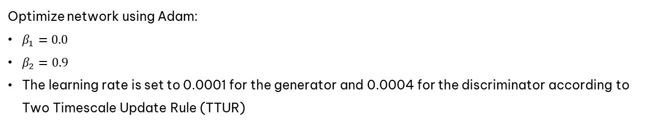
Experiments
Training details
Optimize network using Adam:
$β_{1}=0.0$
$β_{2}=0.9$
The learning rate is set to 0.0001 for the generator and 0.0004 for the discriminator according to Two Timescale Update Rule (TTUR)

Slide 44
Experiments
Evaluation details
To evaluate the performance of our network:
Inception Score (IS): IS computes the Kullback-Leibler (KL) divergence between a conditional distribution and marginal distribution. Higher IS means higher quality of the generated images, and each image clearly belongs to a specific class.
Frechet Inception Distance (FID): computes the Frechet distance between the distribution of the synthetic images and real-world images in the feature space of a pre-trained Inception v3 network. Contrary to IS, more realistic images have a lower FID.
Number of parameters (NoP): to compare the model size with current methods.

Slide 45
Experiments
Quantitative evaluation
Compare the proposed method with several state-of-the-art methods, including StackGAN, StackGAN++, AttnGAN, MirrorGAN, SD-GAN and DM-GAN, which have achieved the remarkable success of text-to-image synthesis by using stacked structures.
Also compared with more recent models (recent models always use extra knowledge or supervisions). For example, CPGAN uses the extra pretrained YOLO-V3, XMC-GAN uses the extra pretrained VGG-19 and Bert, DAEGAN uses extra NLTK POS tagging and manually designs rules for different datasets, and TIME uses extra 2-D positional encoding.

Slide 46
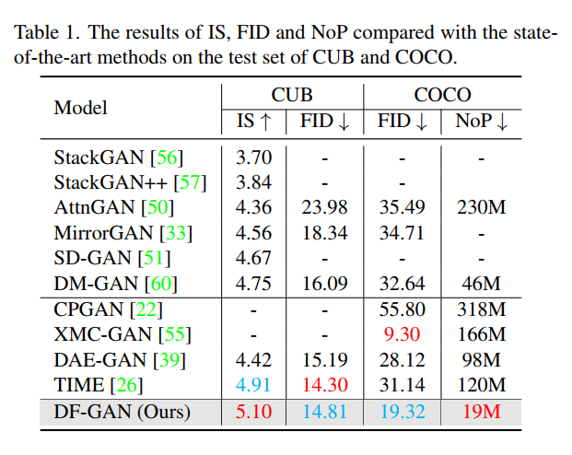
Experiments
Quantitative evaluation

Slide 47
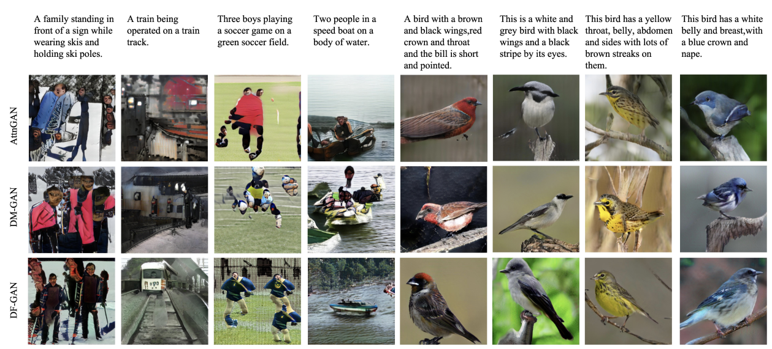
Experiments
Quanlitative evaluation

Slide 48
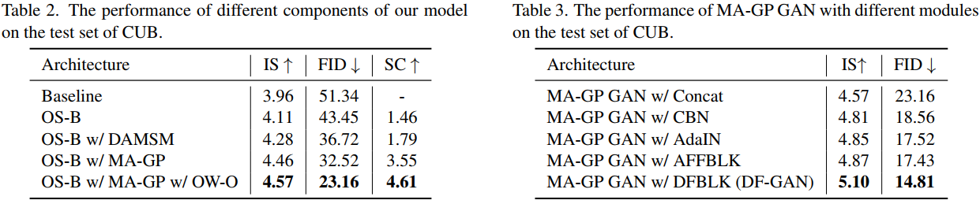
Experiments
Ablation study

Slide 49
Experiments
Re-train: details
Dataset: CUB Bird with 11788 images and 10 language descriptions for each image
Training: 8855 images and 88550 descriptions
Testing: 2933 images and 29330 descriptions
Set up:
GPU: T4
Batch size: 32
Time: ~15mins/epoch
Number of epochs: 310 (paper: 600 epochs)

Slide 50
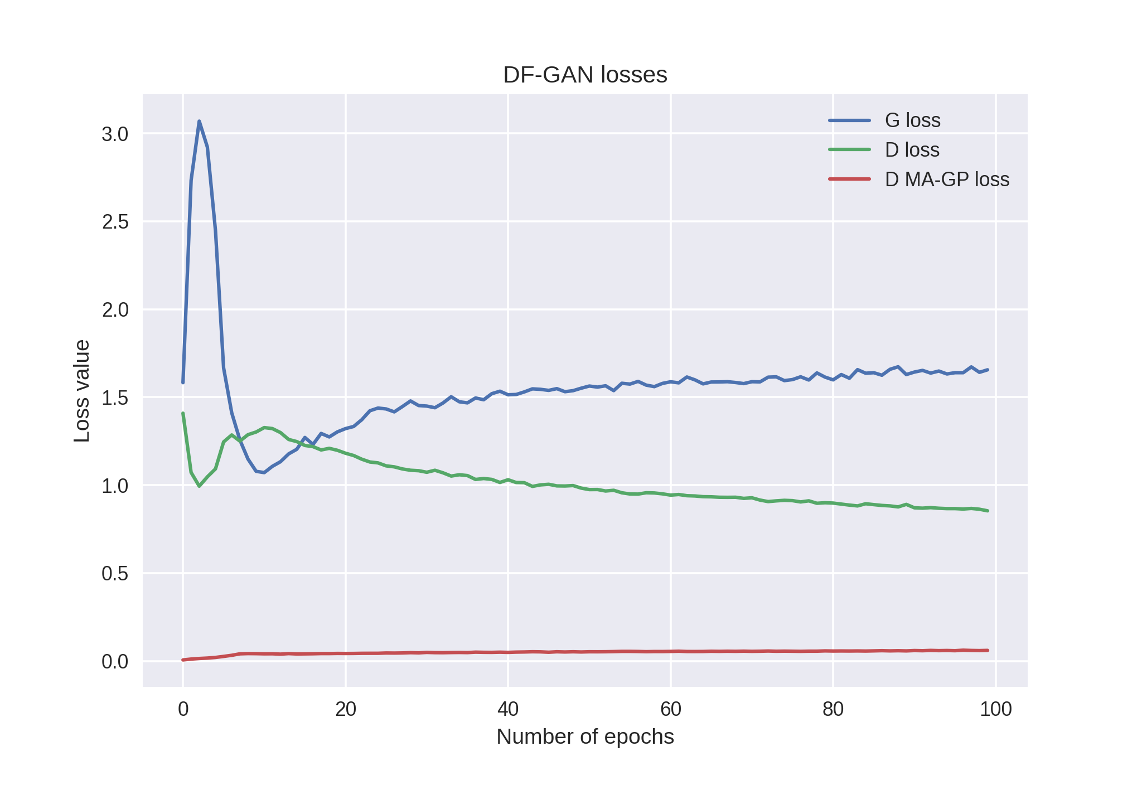
Experiments
Re-train: losses for first 100 epoch

Slide 51
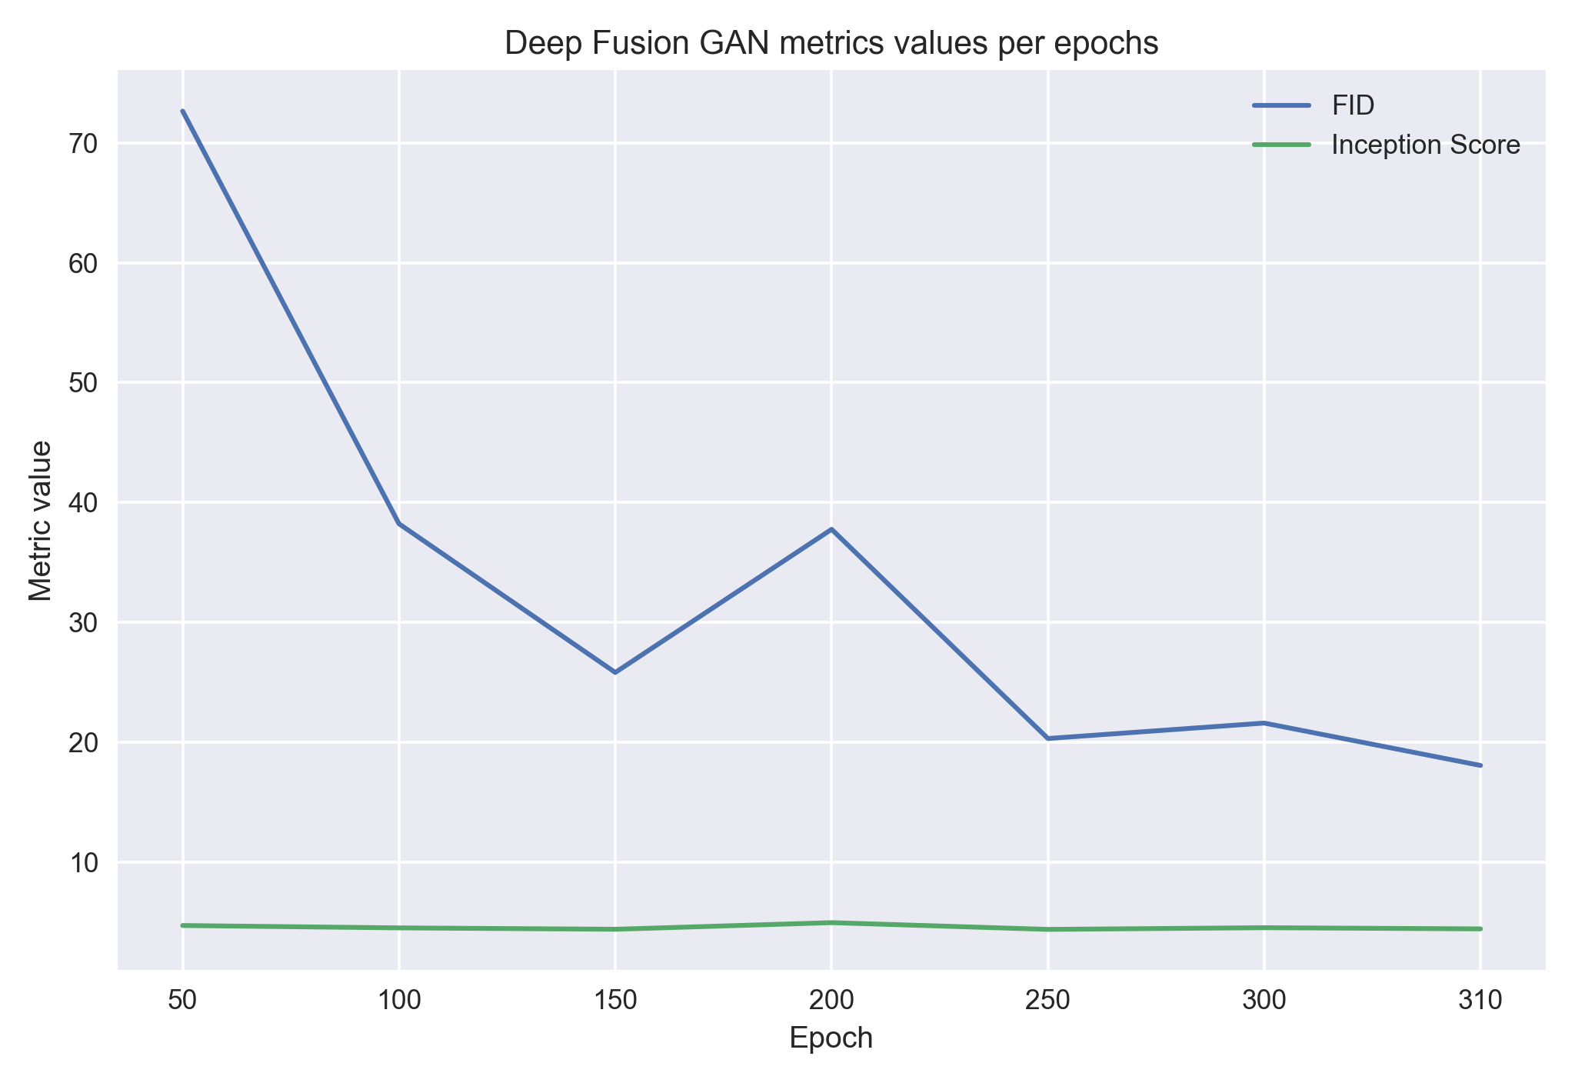
Experiments
Re-train: metrics per epoch

Slide 52
Experiments
Re-train: final metrics
 | Ours | Paper’s
IS | 4.43 | 5.10
FID | 18.10 | 21.42

Slide 53
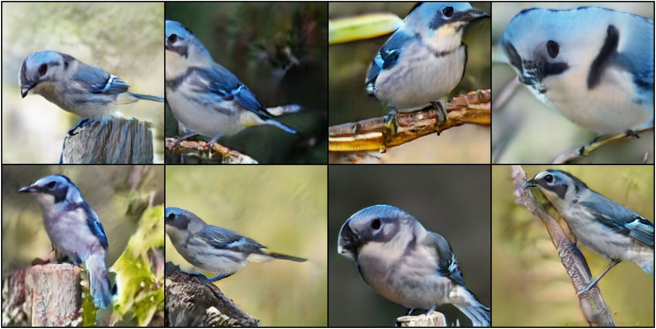
Experiments
Visualizing samples
“this bird has a white belly and breast, with a blue crown and nape”
Notes:
Con chim này có bụng và ngực màu trắng, với một vùng đỉnh và gáy màu xanh lam

Slide 54
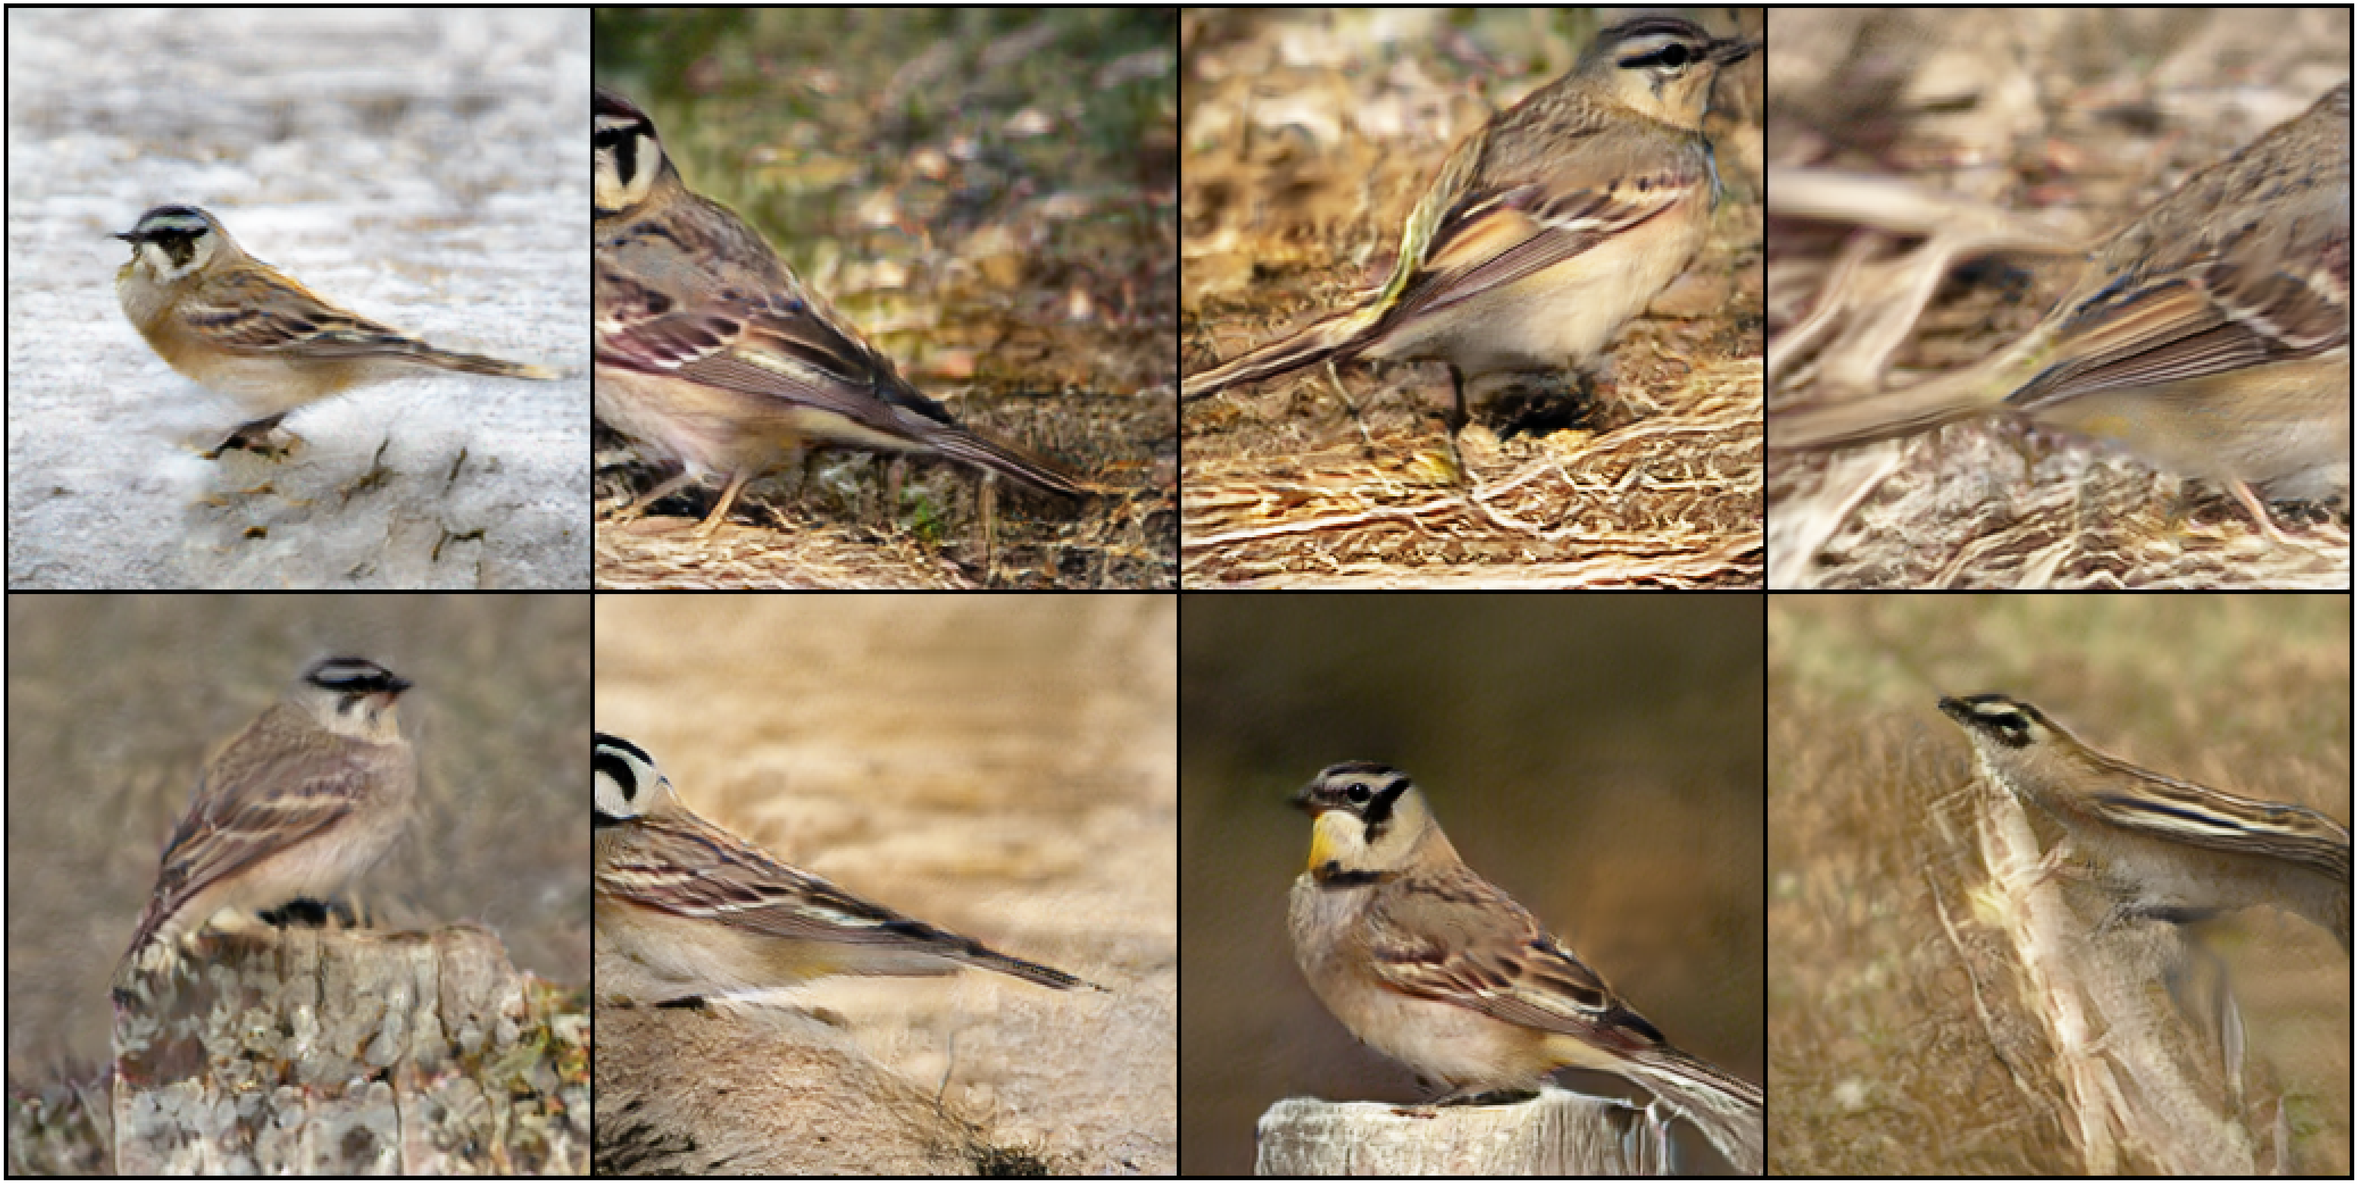
Experiments
Visualizing samples
“A bird with a brown and black wings and a black stripe by its eyes”
Notes:
Một con chim có cánh màu nâu và đen, cùng một vệt đen gần mắt.

Slide 55
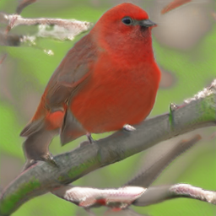
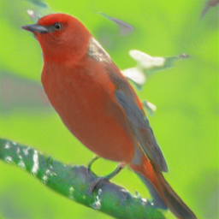
Experiments
Visualizing samples
A small red bird has grey wings
A small red bird has grey long wings

Slide 56
05
Conclusion

Slide 57
Conclusion
Advantages
One-stage text-to-image backbone that can synthesize high-resolution images directly without entanglements between different generators.
Target-Aware Discriminator composed of Matching-Aware Gradient Penalty (MAGP) and One-Way Output can further enhance the text-image semantic consistency without introducing extra networks.
Deep text-image Fusion Block (DFBlock) fully fuses text and image features more effectively and deeply.
Extensive experiment results demonstrate that our proposed DF-GAN significantly outperforms current state-of-the-art models on the CUB dataset and more challenging COCO dataset

Slide 58

Conclusion
Disadvantages and limitations
First, model only introduces the sentence-level text information, which limits the ability of fine-grained visual feature synthesis.
Second, introducing pre-trained large language models to provide additional knowledge may further improve the performance.

Slide 59

Thank for listening!

